Slide 1
Smart Budget Buddy —
Student Edition
Spend Smarter. Save Better. Live Stress-Free.
Team: [Mind Spark]
College: [Dr. Dy Patil Engineering collage ]
Hackathon:
[Arathon]

Slide 2
THE FRICTION
Limited monthly allowance
Student money gets difficult fast
01
02
Daily expenses are hard to track
A small allowance still creates a complex set of daily decisions.
03
Unplanned spending erodes control
04
Saving becomes a vague intention
05
Students lack a clear “safe to spend” number
STUDENT FINANCE

Slide 3
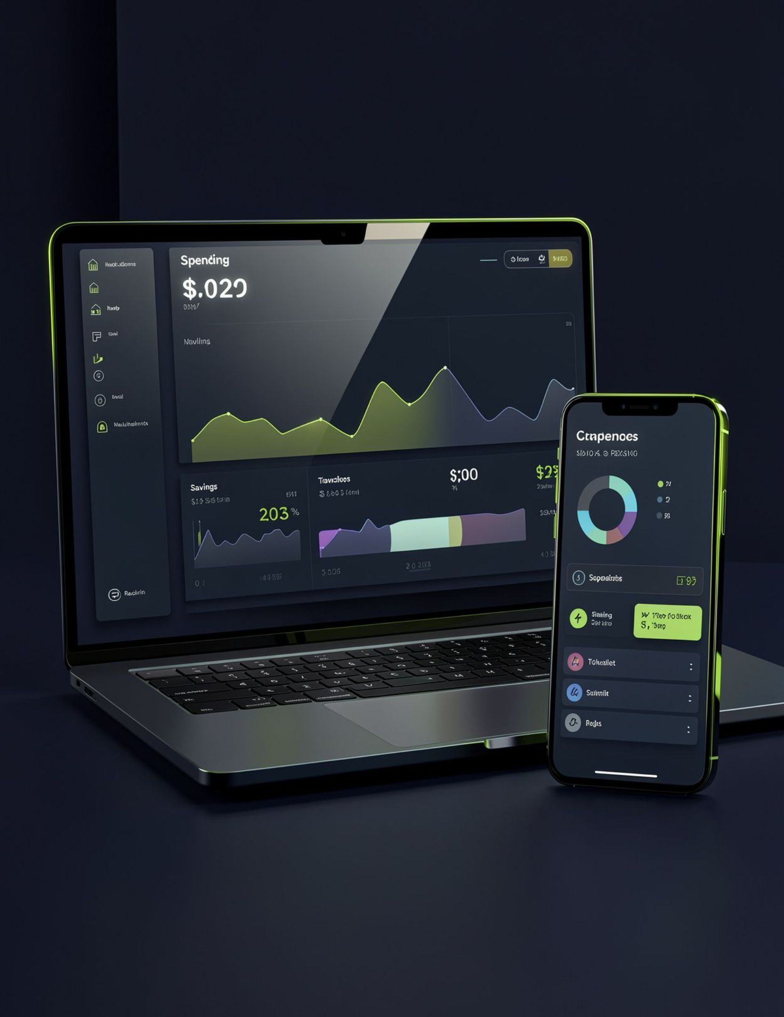
THE PRODUCT
One place to understand every rupee
Smart Budget Buddy is a student-focused personal finance web application for tracking money, controlling spending, and building better financial habits.
01
02
See the current picture
Make the next decision with confidence

Slide 4







THE TOOLKIT
A student finance toolkit, not just a tracker
Smart Dashboard
Spend Before You Buy Calculator
Income and Expense Tracking
Savings Goals
Monthly Spending Forecast
Smart Spending Coach
Daily Safe Spending Calculator

Slide 5




SMARTSPEND AI
SmartSpend AI turns descriptions into categories
Input
Model + rules
User enters a description.
Hybrid classification: TF-IDF + Logistic Regression, supported by keyword rules.
Suggested category
User confirmation
Food, Shopping, Travel, Education, Bills, Entertainment, Other.
User reviews the suggestion before saving.

Slide 6
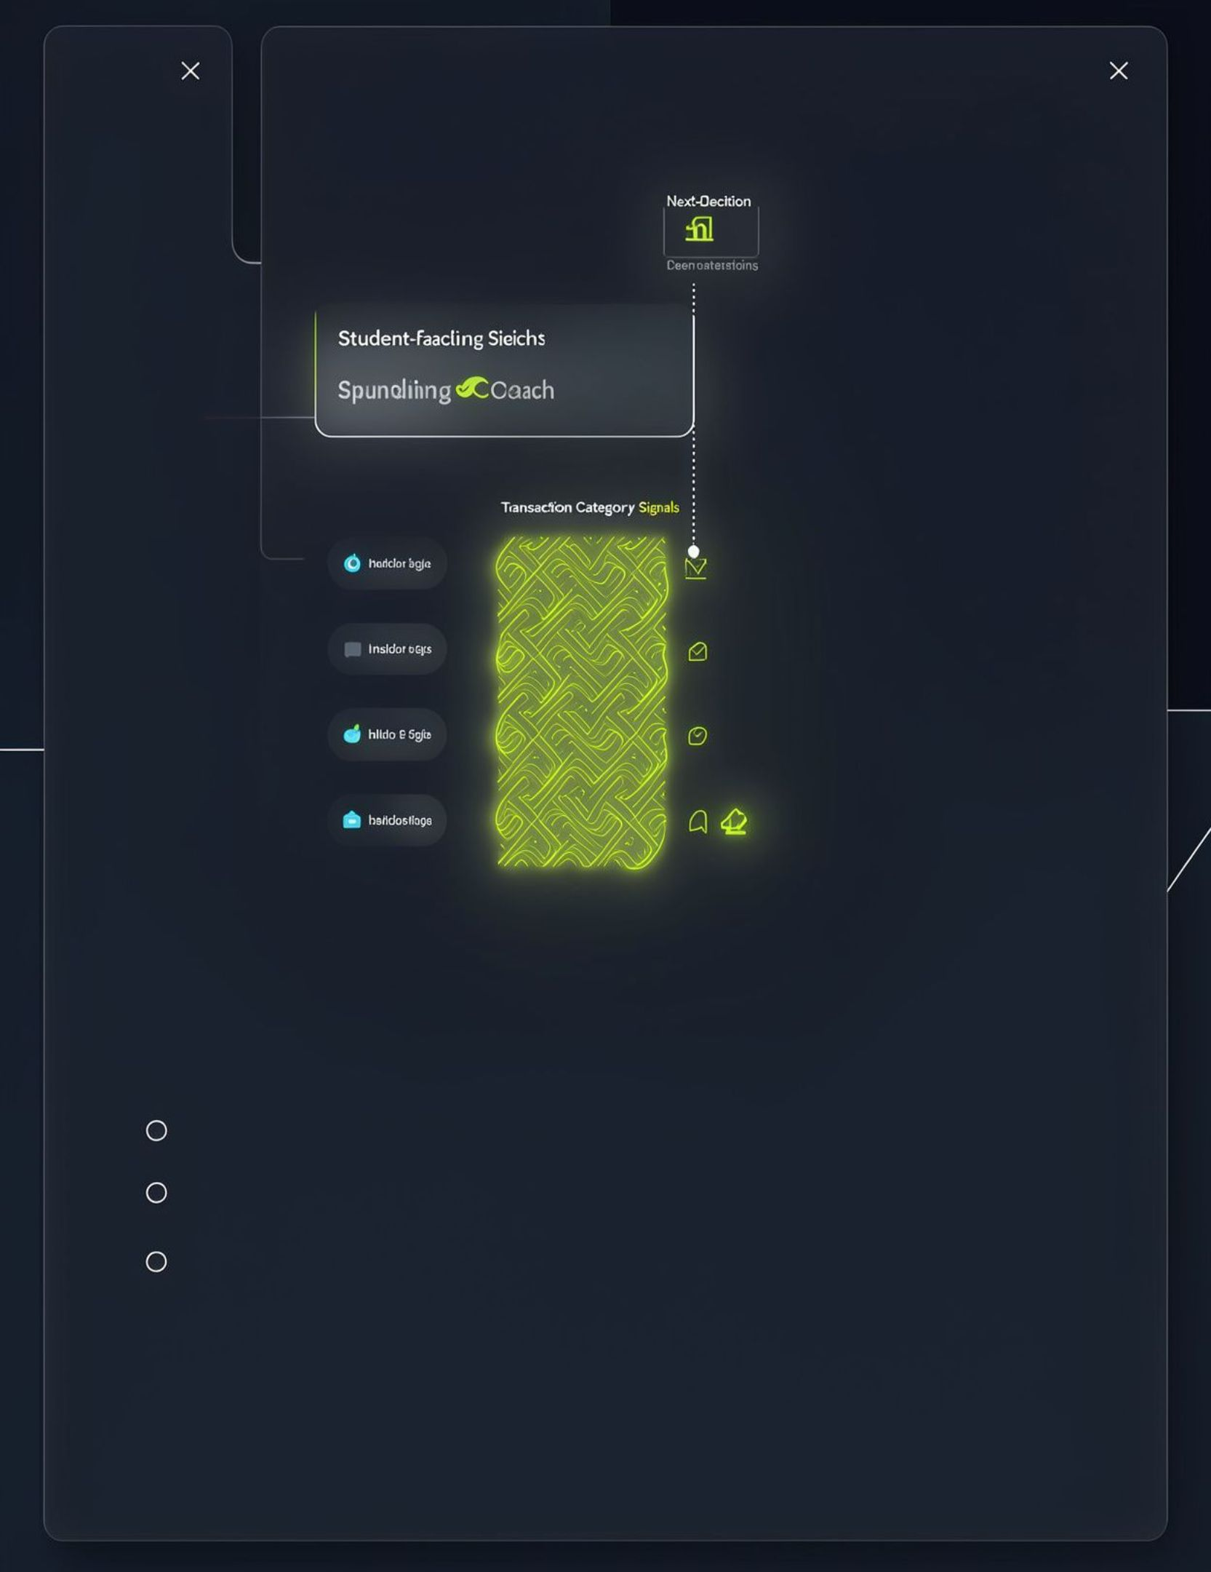
THE COACH
The coach makes spending patterns actionable
SPENDING PATTERN
NEXT DECISION
Recurring spending behavior
Turn patterns into smarter next decisions
Personalised, rule-based insights highlight what keeps repeating.
ACTIONABLE INSIGHT

Slide 7
USER JOURNEY
From transaction to updated dashboard
01
02
03
User enters a transaction
SmartSpend AI suggests a category
User verifies the suggestion
04
05
06
Flask backend processes the transaction
SQLite stores the data
Dashboard updates

Slide 8
THE STACK
HTML | Structure
CSS | Styling
JAVASCRIPT | Frontend functionality
PYTHON + FLASK | Backend
SQLITE | Database
SCIKIT-LEARN | Machine learning
Lightweight stack, focused on the student use case
Each layer stays close to the product's core loop.
FOCUSED BY DESIGN

Slide 9
SYSTEM DESIGN
Simple architecture keeps the loop fast
LAYER 01
LAYER 02
LAYER 03
Frontend
Flask backend
SQLite database
HTML, CSS, JavaScript
Python
Frontend (HTML, CSS, JavaScript) ↔ Flask backend (Python) ↔ SQLite database.
SmartSpend AI classification connects to the backend before confirmed transactions are persisted.

Slide 10
✓
Expense saving and persistence tested
VALIDATION
Validation focused on the core promise
✓
Income and balance updates tested
15
✓
Savings goal persistence tested
automated backend tests passed
✓
SmartSpend AI category suggestions tested

Slide 11
WHAT'S NEXT
11 / 12
Built for today. Ready to grow.
A focused roadmap to make student money management even smarter.
01
02
03
Mobile application
More real-world training data
Spending anomaly detection
Take budgeting and expense tracking beyond the desktop.
Strengthen SmartSpend AI category suggestions with broader examples.
Highlight unusual spending patterns that may need attention.
04
05
Improved forecasting
Deeper personal insights
Develop more advanced estimates as users build transaction history.
Add richer reports and more tailored financial guidance.
ROADMAP • These are planned improvements, not features claimed as currently implemented.

Slide 12
THE TAKEAWAY
12 / 12
SMART BUDGET BUDDY • STUDENT EDITION
Spend smarter.
Save better.
A student-focused finance companion that brings expense tracking, savings tools and SmartSpend AI together in one place.
UNDERSTAND
PLAN
SAVE
See where your money goes
Make more confident spending choices
Build better financial habits
THANK YOU!
Questions & Answers

